Slide 1
Public Hearing on Art 10(4) AMLR – Business-wide risk assessment (BWRA)
28 May 2026
Policy on Private Sector Standards Unit

Slide 2
Agenda
Welcome
Introduction
Presentation on the draft GLs
Exchange of views
Rikke-Louise Ørum Petersen - Board Member Private Sector Standards Unit
Introduction to AMLA and Policy on Private Sector Standards Unit
Floor opened for views from the audience

Slide 3
House keeping
If you cannot hear us, please click on “connect to audio” or click on the three dots at the bottom of the screen and connect audio
If you wish to take the floor:
  Please raise your hand via the dedicated tool
  Once the host gives you the floor, make sure you have enabled microphone in Webex parameters. Unmute yourself and turn the camera on.
  Before providing your views, please introduce yourself (name, sector, Member State).
  Please limit your intervention to 2 min maximum.
In the event of a technical issue, please log out and log in again.
Please do not record this meeting. If you do, you may be removed.

Slide 4
Introduction to AMLA

Slide 5

AMLA’s role
AML/CTF Supervision
Direct supervision some of the most impactful credit and financial institutions (40) and indirectly supervising the rest
Coordination and Support of EU FIUs
Support in cooperation and joint analyses by national FIUs
Regulation
Technical standards and guidelines addressed at: obliged entities, supervisors and FIUs
Oversight and coordination of supervisory authorities in the non-financial sector

Slide 6
What are Guidelines?
RTS: ensure consistent practices and uniform application of EU law
Guidelines:
  set supervisory expectations
  ensure common, uniform and consistent application of EU law.
GLs key features:
  Cannot change the AMLR
  Align with RTS
  Non-legally binding,
Adopted by AMLA
Regulations
RTS
Guidelines
Public hearing on the draft GLs on BWRA

Slide 7
Draft GLs on BWRA
Consultation Paper
28/05/2026
Public hearing on the draft GLs on BWRA

Slide 8
Mandate
Scope of the mandate 10.4
Context
The BWRA is…
The BWRA is not…
AMLA shall issue guidelines:
on the minimum requirements for the content of the BWRA drawn up by the OE pursuant to paragraph 1,
and on the additional sources of information to be taken into account when carrying out the BWRA
Article 10(1) :
“ OEs shall take appropriate measures, proportionate to the nature of their business, including its risks and complexity, and their size, to identify and assess the risks of ML and TF to which they are exposed, as well as the risks of non-implementation and evasion of targeted financial sanctions”
The foundation of the OE’s AML risk-based approach.
Key purposes (AMLR) :
  Risk awareness
  Control gaps identification
  Effective resource allocation
Aligned with FATF Reco 1
Restate requirements from 2015/849 (extended to TFS and new OEs).
Individual Risk assessment (art 20 – AMLR)
Supervisory assessment (art 40(2) – AMLD)

Slide 9
AMLA Approach
Methodology
AMLA’s policy options considered
Developed in interactions with the NCAs from both FS and NFS
Inspired by National best practices (stock take of best practices)
Standardised/ prescriptive BWRA methodology or allow methodological flexibility for OEs?
  → Option chosen : Defining minimum steps and expectations for the BWRA while allowing OE methodological flexibility.
Address the risks linked to TFS within the existing BWRA or through a separate assessment
  → Option chosen : Flexible approach : OE determine, based on their individual risk profiles, whether to address the risks of non-implementation and evasion of TFS within the existing BWRA or through a separate assessment.

Slide 10
AMLA Approach
Simplification
Support to GLs implementation
Avoid unnecessary duplication where AMLR is clear and do not leave room for interpretation. The GLs should therefore be read in conjunction with :
  Minimum list of sources to be used listed in Art. 10(1) deemed sufficiently clear (risk variables/ factors in AMLR Annexes, SNRA, NRA…)
  Art. 10 (2) setting provisions on BWRA elaboration, documentation and updating.
Articulation with other related instruments :
  RTS on 40 (2) AMLD – Proportionality/ data points
  GLs on Art. 9 (4) AMLR on Policies, Procedures and controls
  GLs on Risk variables and Risk factors - Art. 20 (3) AMLR
Development of communication material to accompany the guidelines (factsheet, explainer, sectorial illustrations) – to be published together with the GLs.

Slide 11
Key element of the GLs
Additional sources of information
Minimum requirements
List of requirements that need to be taken into account under Level 1 was deemed sufficiently clear; no further detail added in the GLs
Additional sources to be considered :
BUSINESS AND OPERATIONAL OVERVIEW
IDENTIFY, ASSESS AND CLASSIFY INHERENT RISKS
ASSESS THE QUALITY OF CONTROLS
ASSESS AND CLASSIFY RESIDUAL RISKS
Public/ official authorities and international standards setters
Fraud observatories, central banks, statistical organisations, academia
Industry-level and professional sources
Industry bodies, professional associations, SRB, PPP
Independent external and civil society sources
Risk intelligence report, information from credible and reliable commercial organisations
Internal knowledge and professional expertise
From STR/ SAR/ exchange with FIUs, enforcement and judicial authorities
Findings from internal controls/ supervisory actions

Slide 12
Detailed structure of the GLs
Structure of the GLs
Focus on Proportionality
INTRODUCTION
Scope and Addressees of the Guidelines
GENERAL GUIDELINES
Key principles
Proportionality
Implementation
Identifying and assessing the risks associated with non-implementation and evasion of TFS
METHODOLOGY AND SOURCES OF INFORMATION
Methodology
Sources of information
Use of additional sources of information
MINIMUM REQUIREMENTS
Art 10.1 AMLR​ - BWRA should be proportionate to the OE’s size, nature, and risks.
BWRA is inherently proportionate—its complexity reflecting that of the OE
Exemption possible from the supervisor where the risks in the sector is clear and understood (Art. 10 (3)).
Other options envisaged in draft GLs:​
  Non-complex OEs → may apply a less sophisticated BWRA methodology and opt for a more qualitative and descriptive assessment
  Use a sectoral BWRA developed by their supervisor.
Third parties may assist, with OEs retaining full responsibility.

Slide 13
Next steps
Launch of Public Consultation
Public hearing
End public consultation
AMLA Approval
Publication by AMLA
Consultation Paper
Final Report
Analyse all feedback from the PC & finalise GLs
Preparation of accompanying material
PUBLIC CONSULTATION
16 April
28 May
15 July
Q3 2026
Q4 2026

Slide 14
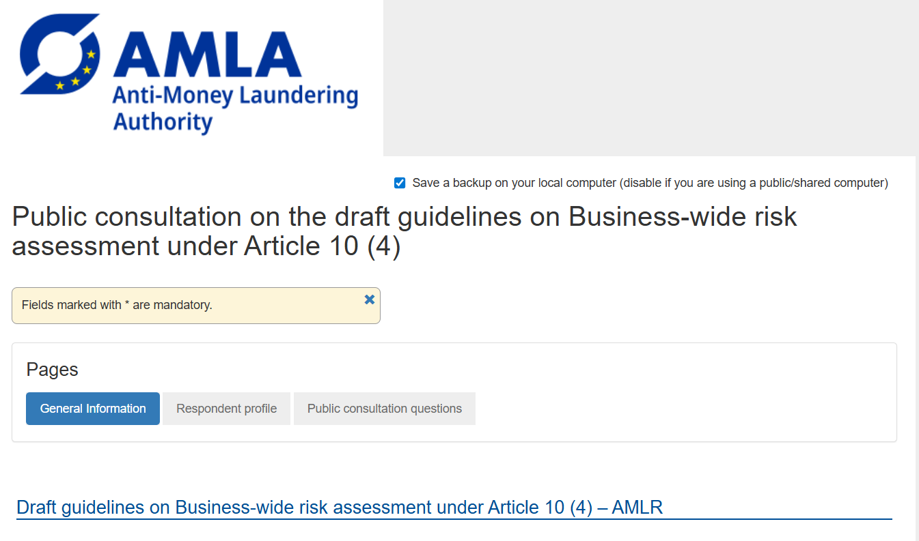
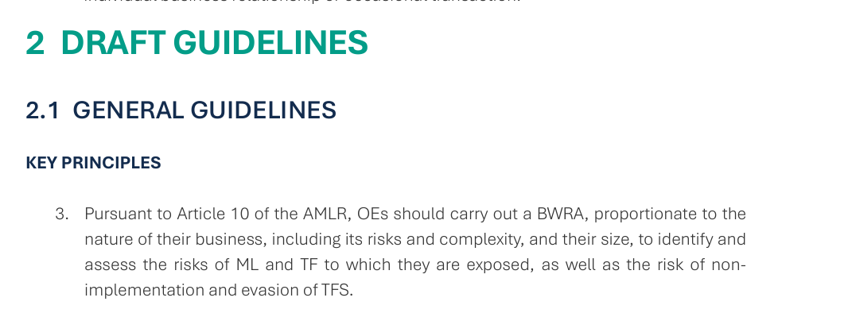
Have your say
Provide your written feedback by 15 July for it to be duly considered.
Consultation on the draft Guidelines on business-wide risk assessment - Authority for Anti-Money Laundering and Countering the Financing of Terrorism
https://ec.europa.eu/eusurvey/runner/4cab2d4e-afb5-9396-d0eb-cadfd1fcb138
Ensure to follow the instructions when providing your comments :
  Clearly specify the provision concerned with clear reference to the number of the paragraph referred to.
  Provide concrete drafting proposals and explain why it would be appropriate

Slide 15
Floor open for views from the audience

Slide 16
Floor open for views from the audience
If you wish to take the floor:
  Please raise your hand via the dedicated tool
  Once the host gives you the floor, make sure you have enabled microphone in Webex parameters. Unmute yourself and turn the camera on.
  Before providing your views, please introduce yourself (name, sector, Member State).
  Please limit your intervention to 2 min maximum.
In the event of a technical issue, please log out and log in again.
Please do not record this meeting. If you do, you may be removed.

